Slide 1
IBM University Engagement Project Submission
“Exploring the Power of Agentic AI with IBM Cloud and Orchestrate”

Slide 2

Project Tile – Social Media Agent
Domain of Project – Social Media Analytics & Marketing
Student Name | Recent Passport Photo | Email ID | Mobile number [WhatsApp]
Samruddhi Meher |  | mehersam613@gmail.com | 9595739476

Slide 3
Problem Statement -
Problem Statement No.10 : Social Media Agent
The Challenge
Brands, influencers, and organizations struggle to keep up with the fast-paced and fragmented world of social media. Content trends evolve hourly, audience sentiment shifts rapidly, and competitor strategies are difficult to track. Managing multiple platforms often leads to scattered insights, missed engagement opportunities, and ineffective campaigns. The challenge is not only to collect social media data but also to analyze, predict, and recommend actions in real time.
The Objective
Build an agentic AI application that acts as an intelligent social media companion. The solution should:
Fuse Multichannel Data :- Collect and synthesize content, comments, hashtags, and competitor posts from platforms like X, LinkedIn, Instagram, and Facebook into unified insights.
Enable Multimodal Interaction :- Accept user inputs (text, images, or voice prompts) and generate creative post drafts, captions, or campaign ideas aligned with brand tone.
Create a Predictive & Agentic Layer :- Forecast trending hashtags, audience sentiment shifts, and competitor engagement patterns while suggesting the best posting schedules.
Visualize Social Media Pulse :- Provide a dashboard with real-time analytics—engagement trends, influencer mapping, sentiment tracking, and campaign performance forecasts.

Slide 4
Proposed Solution -
Proposed Solution: VibeLens AI – AI-Powered Social Media Agent
The proposed solution is VibeLens AI, an AI-powered social media agent that helps brands, influencers, and organizations manage their online presence through intelligent insights and content recommendations. The platform analyzes social media trends, audience sentiment, engagement metrics, and competitor activity to support data-driven decision-making.
Key features include:
Trend Analysis – Identifies trending topics and hashtags.
Sentiment Analysis – Monitors audience opinions and reactions.
Content Generation – Suggests captions, hashtags, and campaign ideas.
Competitor Tracking – Analyzes competitor performance and strategies.
Smart Scheduling – Recommends optimal posting times.
Analytics Dashboard – Visualizes engagement and campaign performance.
Overall, VibeLens AI acts as a smart social media companion that helps users create impactful content, improve engagement, and stay ahead of market trends.

Slide 5
Technology Used
IBM Langflow – For designing and managing multi-agent workflows visually.
IBM Granite Model – For content generation, sentiment analysis, and intelligent recommendations.
IBM Watson Orchestrate – For building and automating the AI Social Media Agent.
IBM Watsonx.ai – For AI model deployment, embeddings, and governance.
IBM Cloud – For secure, scalable, and reliable application hosting.
RAG (Retrieval-Augmented Generation) – For retrieving real-time social media insights before generating responses.
FAISS/Chroma Vector Database – For efficient storage and retrieval of social media knowledge embeddings.
Social Media APIs – For collecting trends, hashtags, engagement, and audience data.
HTML, CSS, JavaScript – For developing the responsive VibeLens AI dashboard.

Slide 6
Orchestrate component Used -
1) Chat Input – Interface where users enter social media-related queries, brand details, campaign goals, or content requirements through text, voice, or images.
2) IBM watsonx AI Agent – Processes user inputs using IBM Granite models to analyze trends, generate content, evaluate sentiment, and provide social media recommendations.
3) IBM Granite Model – Granite-4.0-8B-Instruct → Fast and efficient for content generation, hashtag recommendations, sentiment analysis, and social media strategy suggestions.
4) Chat Output – Displays AI-generated responses such as captions, hashtags, trend insights, competitor analysis, posting schedules, and campaign recommendations.
5) File Component – Stores social media data, campaign reports, engagement metrics, sentiment analysis results, and user preferences for future reference and analytics.

Slide 7
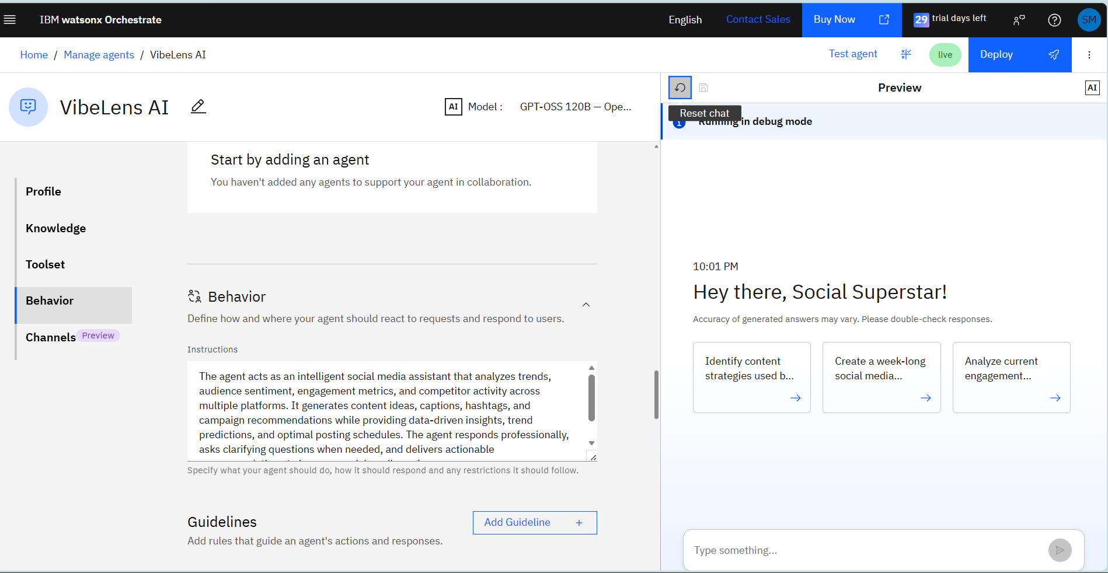
Agent Instructions Screenshot-

Slide 8
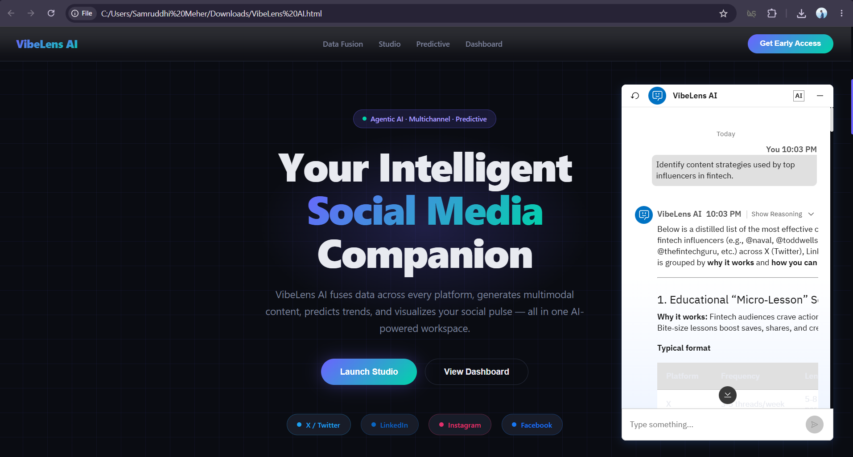
Prompt with output Screenshot:

Slide 9
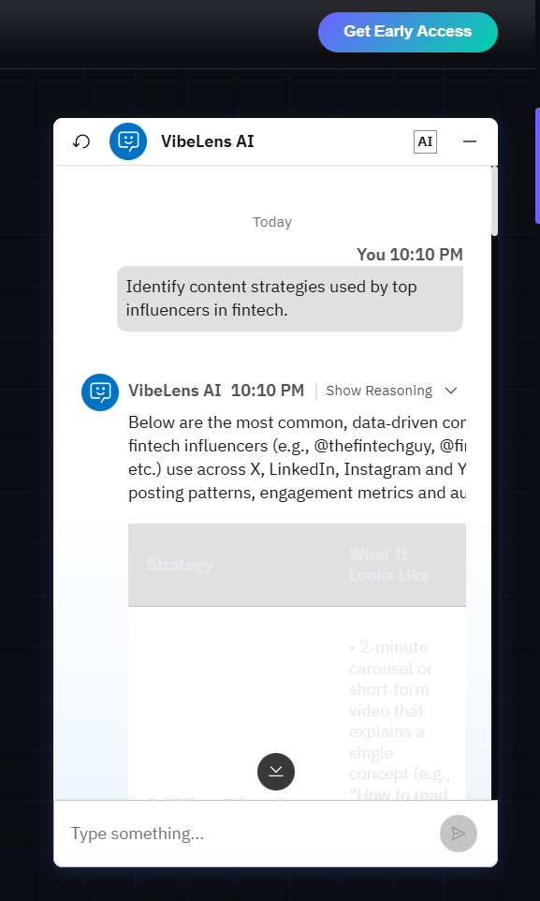
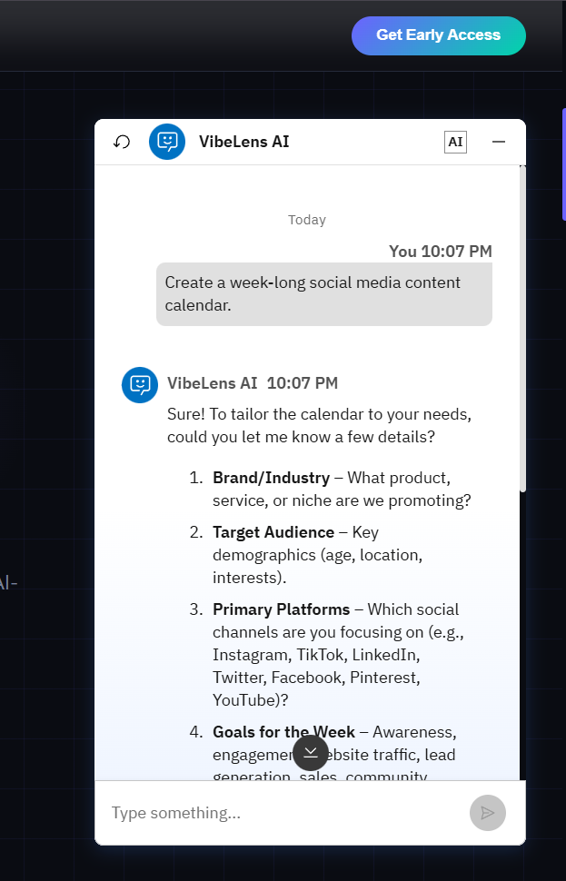
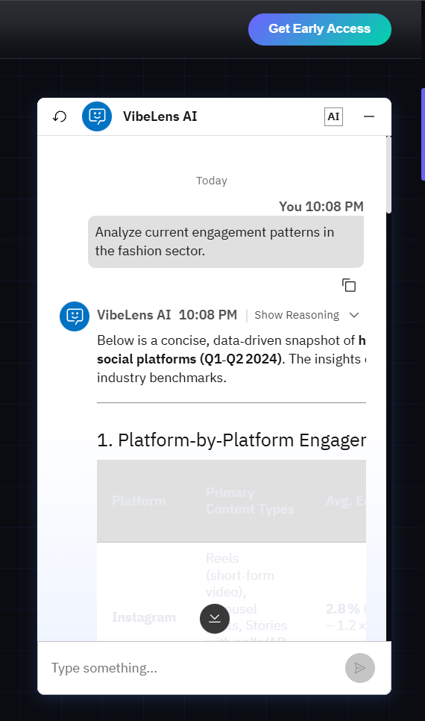
Other Applicable Screenshots :

Slide 10

Role of Agentic AI in the solution
Role of Agentic AI in VibeLens AI
Agentic AI acts as the decision-making engine of VibeLens AI, enabling the system to perform tasks autonomously and provide intelligent social media assistance. It continuously analyzes social media data, including posts, comments, hashtags, engagement metrics, and competitor activities, to identify trends and audience behavior patterns.
The AI agent can generate creative captions, hashtags, campaign ideas, and content strategies tailored to a brand's goals and target audience. It proactively recommends the best posting times, detects shifts in audience sentiment, and suggests actions to improve engagement and reach.
By combining real-time data analysis, predictive insights, and automated recommendations, Agentic AI helps brands, influencers, and organizations make informed decisions, optimize marketing campaigns, and stay ahead of emerging social media trends. This reduces manual effort while improving the effectiveness and impact of social media strategies.

Slide 11
Novelty and Uniqueness
The proposed VibeLens AI stands out by combining Agentic AI, real-time trend analysis, sentiment monitoring, and predictive insights into a single intelligent platform.\
1. Multi-Agent Intelligence – Specialized agents analyze trends, sentiment, competitors, and content performance.
2. Real-Time Trend Analysis – Identifies trending topics and viral hashtags across platforms.
3. Predictive Insights – Forecasts engagement trends and audience behavior.
4. Personalized Recommendations – Generates captions, hashtags, and campaign ideas tailored to brand goals.
5. Competitor Intelligence – Monitors competitor strategies and engagement patterns.
6. Multi-Modal Interaction – Supports text, voice, and image-based inputs.
7. Enterprise-Ready – Built on IBM Watson Orchestrate, IBM Granite Models, and IBM Cloud.
This makes VibeLens AI a smart social media strategist, not just a traditional analytics tool.

Slide 12
Github URL – https://github.com/mehersam7/SOCIAL-MEDIA-AGENT Developed by – Samruddhi Randhir Meher (T.E)
GitHub Link :

Slide 13
Future Scope
AI Content Automation – Automatically generate and schedule posts across multiple social media platforms.
Advanced Predictive Analytics – Forecast viral trends, audience behavior, and campaign performance with higher accuracy.
Influencer Collaboration Engine – Identify and recommend suitable influencers based on audience demographics and engagement.
Multi-Language Support – Generate content and analyze sentiment in multiple languages.
AI-Powered Crisis Detection – Detect negative sentiment spikes and reputation risks in real time.
Enhanced Competitor Intelligence – Provide deeper insights into competitor strategies and market positioning.
Platform Expansion – Integrate additional platforms such as YouTube, TikTok, and Threads for comprehensive social media monitoring.
·
·
·

Slide 14
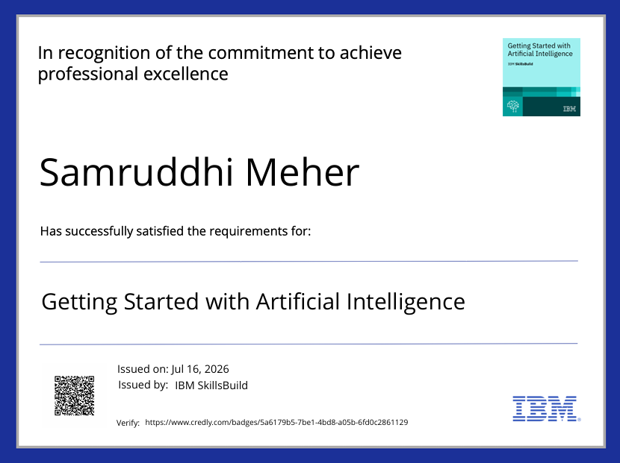
Certificates Earned:

Slide 15
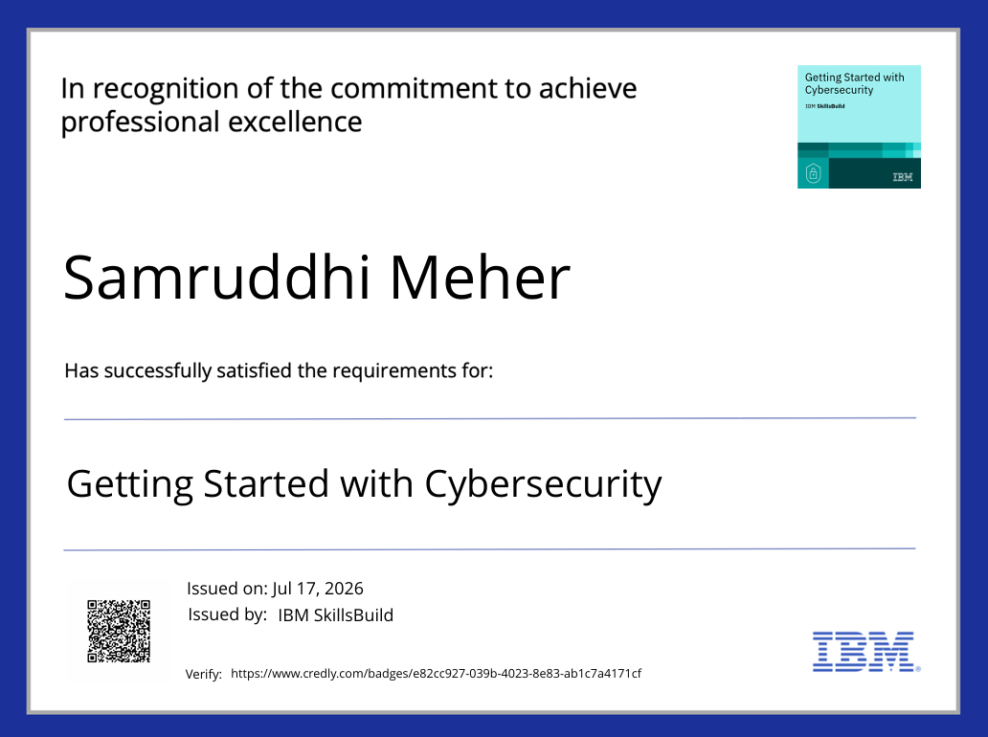

Slide 16
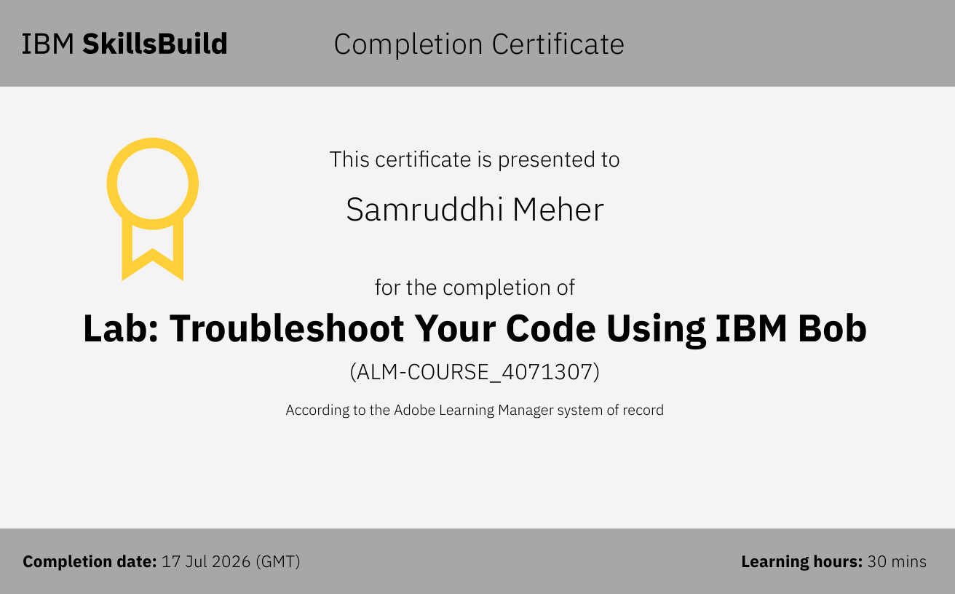
Certificates Earned:​

Slide 17


